Slide 1
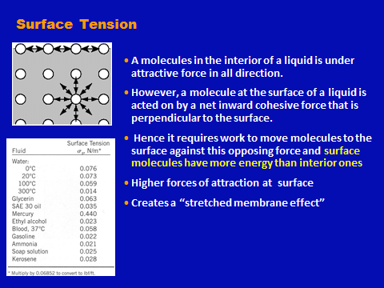
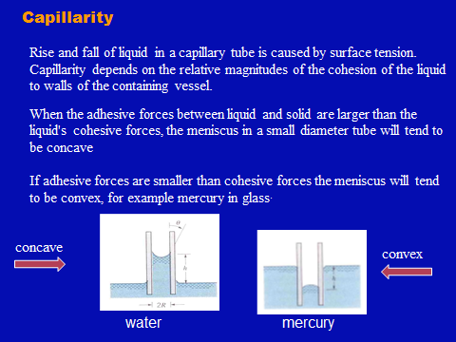
Fluid Mechanics Class Note
Dr. Qassem Hamed Jalut Associate Professor

Slide 2
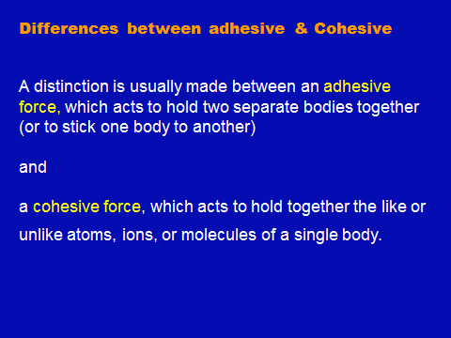
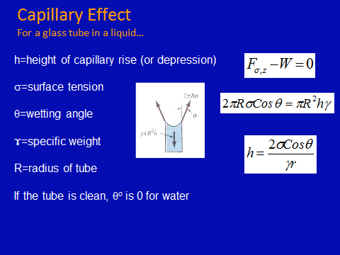
Fluid Mechanics Class Note
Dr. Qassem Hamed Jalut Associate Professor

Slide 3
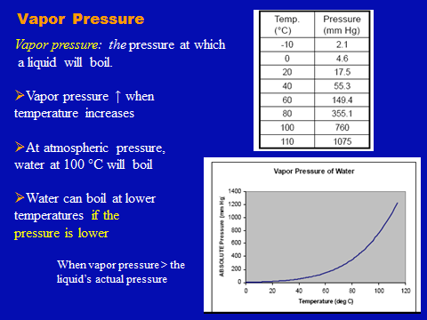
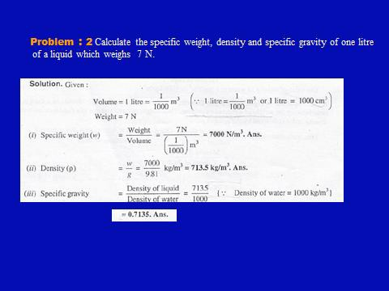
Fluid Mechanics Class Note
Dr. Qassem Hamed Jalut Associate Professor

Slide 4
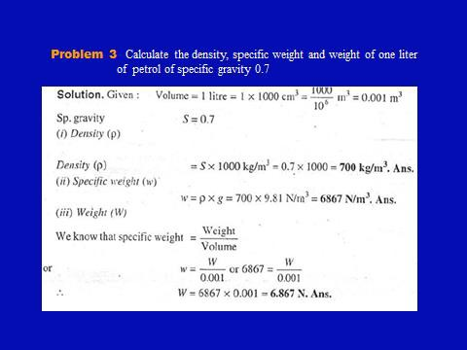
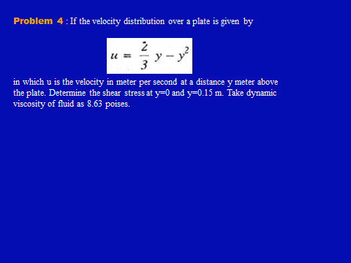
Fluid Mechanics Class Note
Dr. Qassem Hamed Jalut Associate Professor

Slide 5
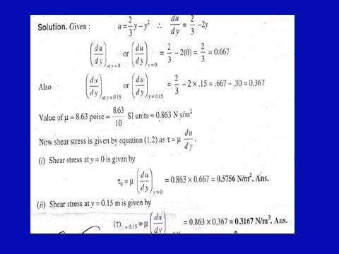
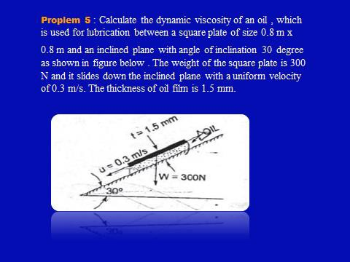
Fluid Mechanics Class Note
Dr. Qassem Hamed Jalut Associate Professor

Slide 6
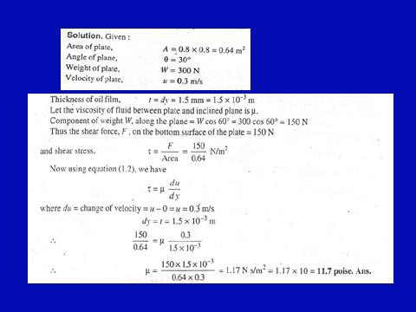
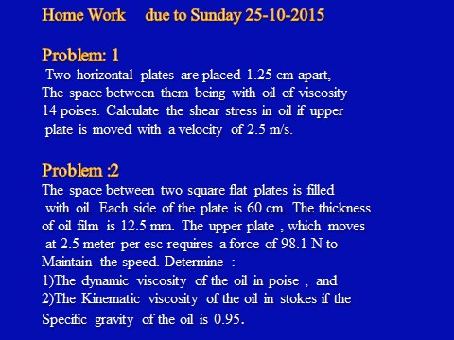
Fluid Mechanics Class Note
Dr. Qassem Hamed Jalut Associate Professor

Slide 7
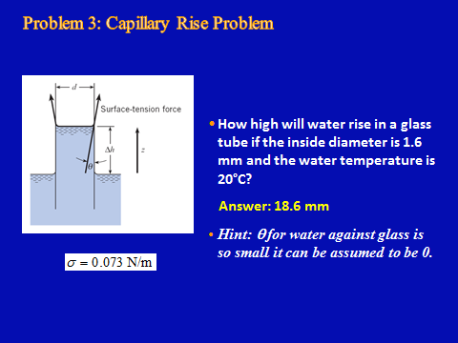
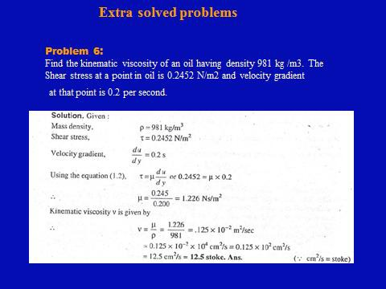
Fluid Mechanics Class Note
Dr. Qassem Hamed Jalut Associate Professor

Slide 8
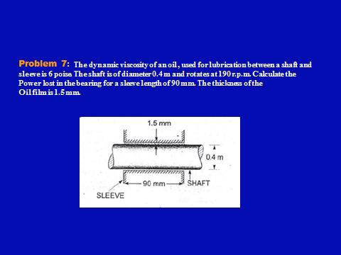
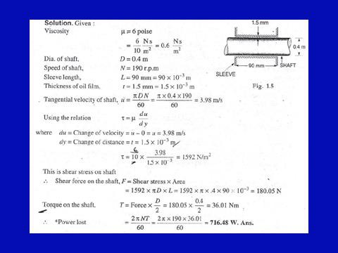
Fluid Mechanics Class Note
Dr. Qassem Hamed Jalut Associate Professor

Slide 9
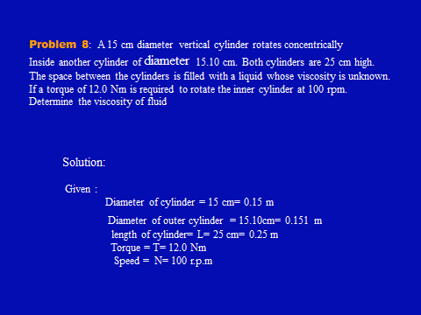
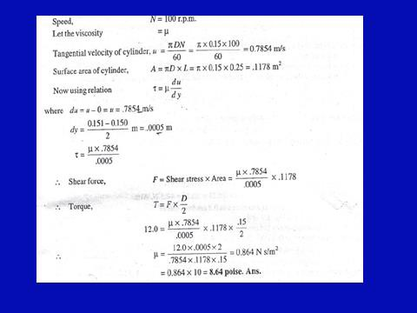
Fluid Mechanics Class Note
Dr. Qassem Hamed Jalut Associate Professor
30

